Slide 1
Unidad 1: Introduccion al estudio del medio ambiente
Unit 1: Introduction to the study of the environment

Slide 2
Aim and Do Now September 10, 2013
Aim: What is the scientific method and describe the steps involved?
Que es el metodo cientifico y describe los pasos involucrados?
Do Now: What must a scientist do before performing an experiment?
Que debe de hacer un cientifico antes de ejercer un experimento?

Slide 3
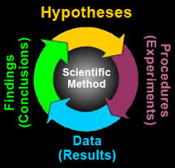
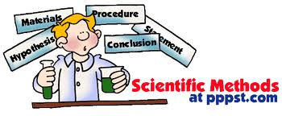
El metodo cientifico
The scientific method

Slide 4
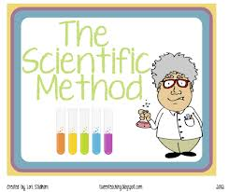
Que es el metodo cientifico?
The universal approach that scientists utilize to test an idea
El __________ universal que cientificos __________ para experimentar un idea

Slide 5
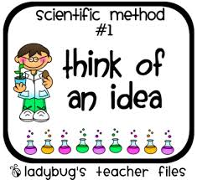
Cuales son los pasos del metodo cientifico?
Step 1: define the problem to be tested
Paso 1: __________ el _________ que va hacer experimentado

Slide 6
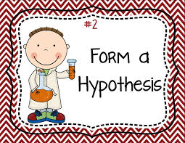
Cuales son los pasos del metodo cientifico?
Step 2: Formulate a hypothesis (a possible explanation for an observed set of facts)
Paso 2: _____________ un __________ (una posible _____________ para un conjunto de _________ observado

Slide 7
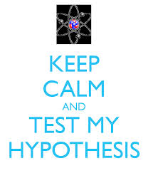
Cuales son los pasos del metodo cientifico?
Step 3: Test the hypothesis
Paso 3: ___________ el

Slide 8
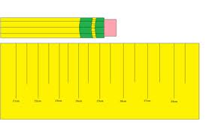
Cuales son los pasos del metodo cientifico?
Step 4: Observations and measurements

Slide 9
Cuales son los pasos del metodo cientifico?
Step 5: Analysis
Step 6: Conclusions
Step 7: Repeat the experiment
Why should the experiment be repeated again?

Slide 10
So what are the steps of the scientific method again?
Step 1:
Step 2:
Step 3
Step 4:
Step 5:
Step 6:
Step 7:

Slide 11
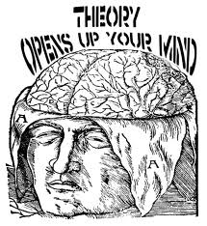
What is a theory?
explanation that applies to a broad range of phenomena which is supported by facts and evidence.
___________ que ___________ a una amplia gama de fenomenos que son ___________ por hechos y ____________

Slide 12
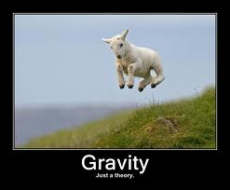
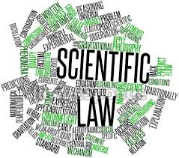
What is a scientific law ?
After a theory has been tested completely and is always accepted to be true, it may become a scientific law.

Slide 13
Unidades de medida estandar internacional
SI Measurement Units

Slide 14
What is the standard unit for each of these?
Metro (________)- m- La unidad estándar para________________ (length)
Gramo (________)- g- La unidad estándar para________________ (mass/weight)
Litro (_________)- l- La unidad estándar para_________________ (volume)

Slide 15
Prefijos comunes del SI
Prefijo-Prefix | Simbolo | Valor Numerico | Valor Decimal
Mega | M | 1,000,000
Kilo | K | 1,000
Hecto | ha | 100
Deka | da | 10
Deci | d |  | .1
Centi | c |  | .01
Milli | m |  | .001
Micro | µ |  | .000001
Nano | n |  | .000000001

Slide 16
Escalas de temperatura- Temperature Scales
Escala- Scale | Bp of water | Fp of water | Body Temp | Room Temp
Fahrenheit | 212⁰ | 32⁰ | 98.6⁰ | 70⁰
Celsius | 100⁰ | 0⁰ | 37⁰ | 21⁰
Kelvin | 373⁰ | 273⁰ | 310⁰ | 254⁰

Slide 17
Tipos de Microscopios
Types of Microscopes

Slide 18
Tipos de Microscopios
Light Microscope
Simple Microscope
Compound Microscope

Slide 19
Light Microscope
Light Microscope: Any device (aparato) that uses light to produce an enlarged view of an object.

Slide 20
Simple Microscope
Simple Microscope – The first microscopes had only one lens. They used refracted light to produce an image. Also known as a magnifying glass they could magnify (magnifica) up to 100x.
Refracted light (luz refractada)- when the light bends

Slide 21
Compound Microscope
Compound Microscope – Utilizes (utiliza) two lenses. One lens produces an enlarged image (imagen engrandecida) that is further magnified by the second lens. A compound microscope has a light source, two lenses and a mechanical system for adjusting (ajustar) the focus (enfoque) and image (imagen).

Slide 22
Terminologia Microscopio
Microscope Terminology

Slide 23
Magnification
Magnification- A measure (medida) of how much the image is magnified Total Magnification= objective lens x ocular lens
Ex. Eyepiece or ocular lens (10x) x Objective lens (40x) = 400x

Slide 24
Resolution
Resolution- The clarity (claridad) of an image.
As magnification increases, resolution decreases.

Slide 25
Field of View
As you increase (aumentas) the magnification, the size of the background (fondo) or field of view decreases

Slide 26
Microscope Parts
Partes del Microscopio

Slide 27
Microscope Parts
Microscope Part | Function of Microscope part
Eyepiece (ocular) | Magnifies the image
Arm | Support the upper microscope parts and used to carry the microscope
Body tube | Support and adjusts the lenses
Objective lens | Magnify objects (4x, 10x, 40x, 43x)
Course adjustment knob | Used to make large changes in focus. NOTE Never use this when viewing on high power

Slide 28
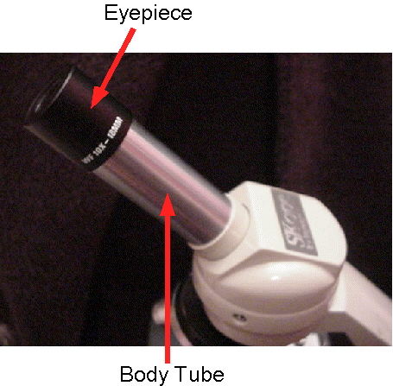
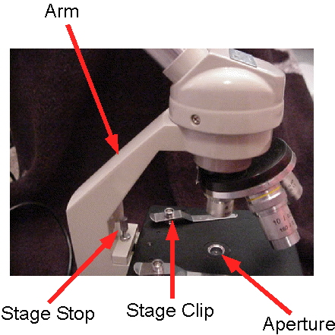
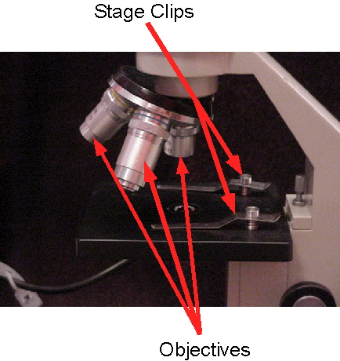
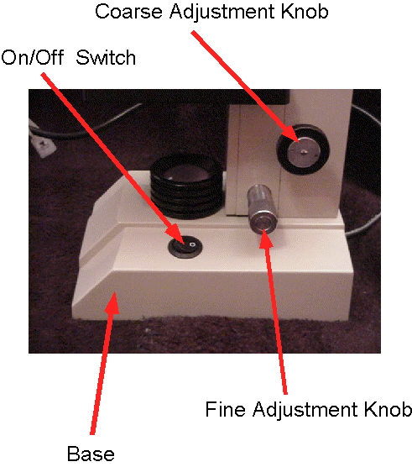

Slide 29
Microscope parts
Microscope Part | Function of the microscope part
Fine Adjustment knob | Brings objects into sharp focus
Nosepiece | Holds (detiene) the objective lenses
Stage | Holds the slide
Stage clips | Holds specimen in place
Diaphragm | Adjusts the light that enters
Lamp or light source | Provides light
Base | Supports the microscope
pivot | Allows tilting the scope for easy viewing

Slide 30
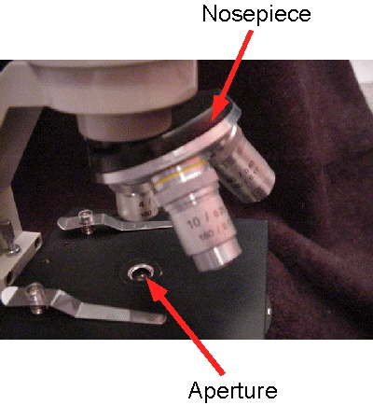
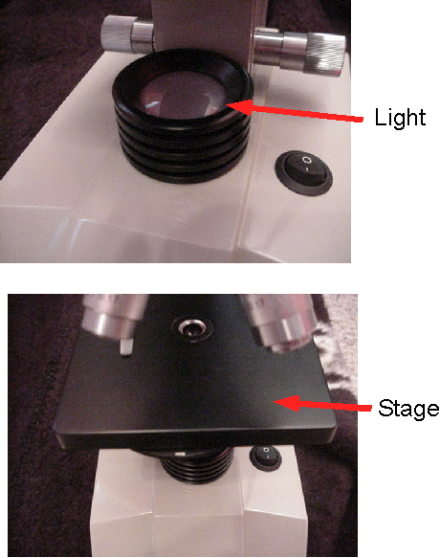
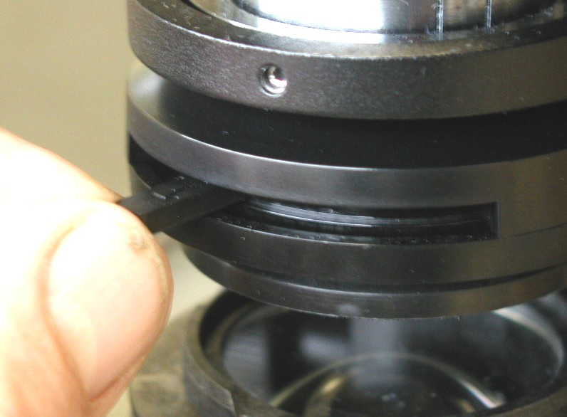

Slide 31
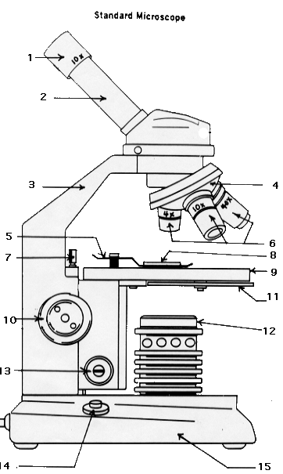
1.____________________
2.____________________
3.____________________4.____________________
5.____________________
6.a.__________________
b.__________________
c.__________________
7.____________________
8.____________________9.____________________
10.___________________
11.__________________
12. __________________
13.___________________
14.___________________
15.___________________
On/off switch
Light source
Slide
Coarse adjustment
Fine adjustment
Stage
Stage clip
Scanning objective
Low power objective
High power objective
Ocular lens
Base
Diaphragm
Body tube
Arm
Stage stop
nosepiece
http://www.cas.muohio.edu/~mbi-ws/microscopes/microscopeparts.html

Slide 32
Laboratory Techniques
Tecnicas de laboratorio

Slide 33
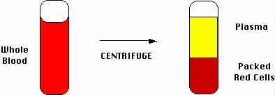
Centrifugation- Centrifugacion
Centrifugation: Materials spin and are separated based on their density. The particles with a higher density in the liquid will push themselves to the bottom of a test tube that has been spun in a centrifuge.

Slide 34
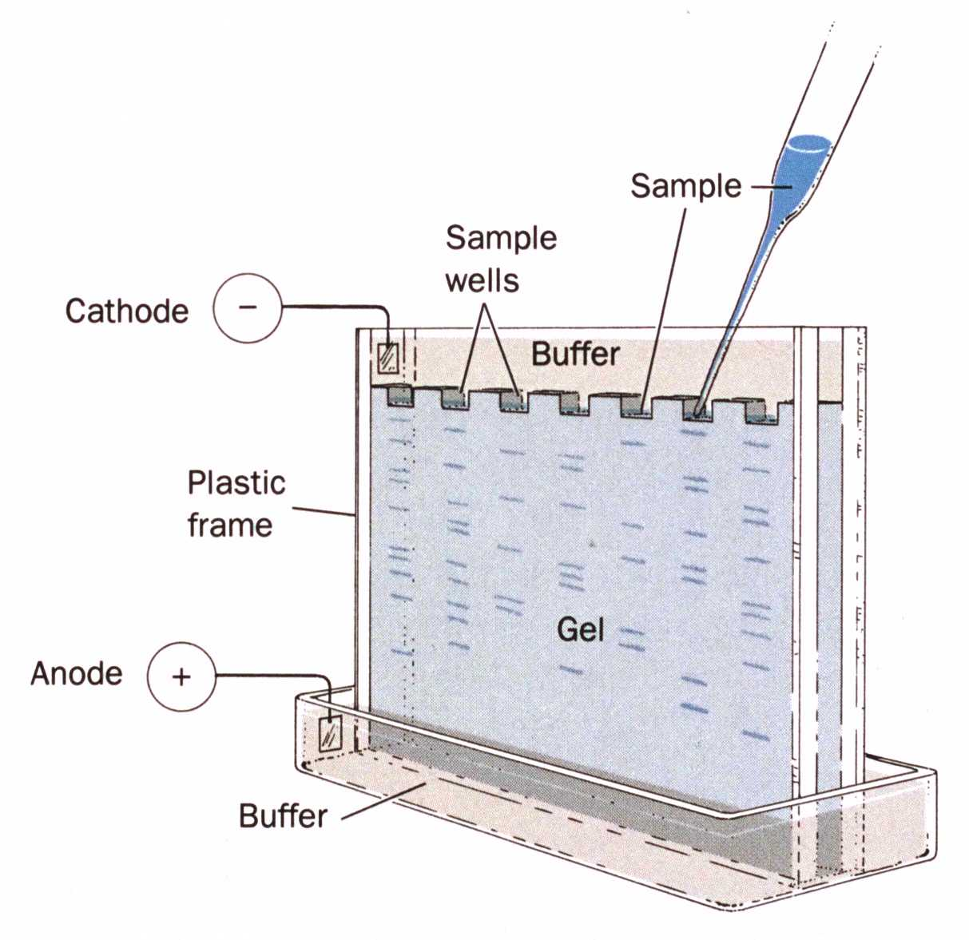
Electrophoresis- electroforesis
Electrophoresis (electrophoresis): The technique for separating molecules of DNA that have an electrical charge. The distance each fragment moves in an electrical field is dependent upon the size of the molecules in the substance.

Slide 35
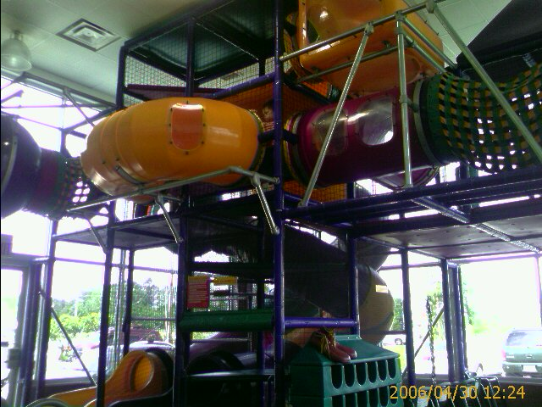
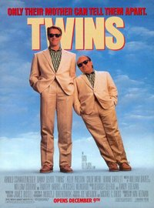
Gel Electrophoresis
Which of these twins could move
faster through the playtube?

Slide 36
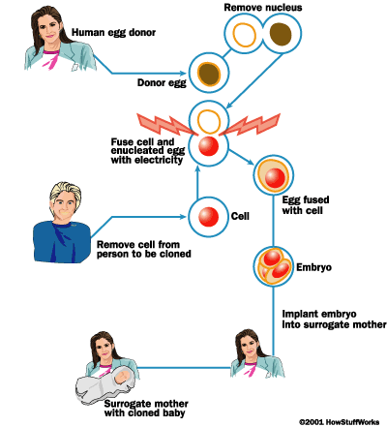
Micro- Dissection- Dissecion micro
Micro-dissection: A micromanipulator is attached to the microscope stage that allows a doctor to use tiny tools to perform various operations on living things.
Ex. Cloning
Ex. Microsurgery

Slide 37
Chromatography- cromatografia
Chromatography (cromatografía): A method used to separate & identify chemical substances based upon differences in solubility in a solvent.

Slide 38
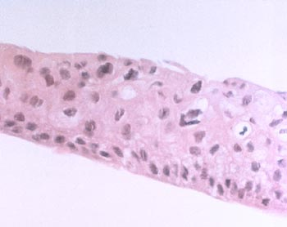
Tissue culture- cultivo de tejido
Tissue Culture: The technique of maintaining living cells or tissues in a culture medium outside the body. Ex. Growing embryos in a test tube Ex. skin grafts (injertos de piel)

